Slide 1
Berry Curvature Involvement in the Inverse Faraday Effect
(The response of orbital magnetic moment of time-reversal symmetric materials to a circular driver)
Mahmut Sait OKYAY, Noejung Park
UNIST

Slide 2
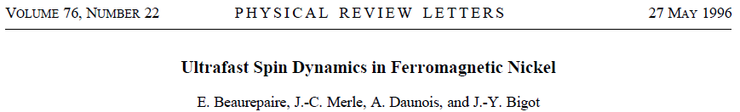
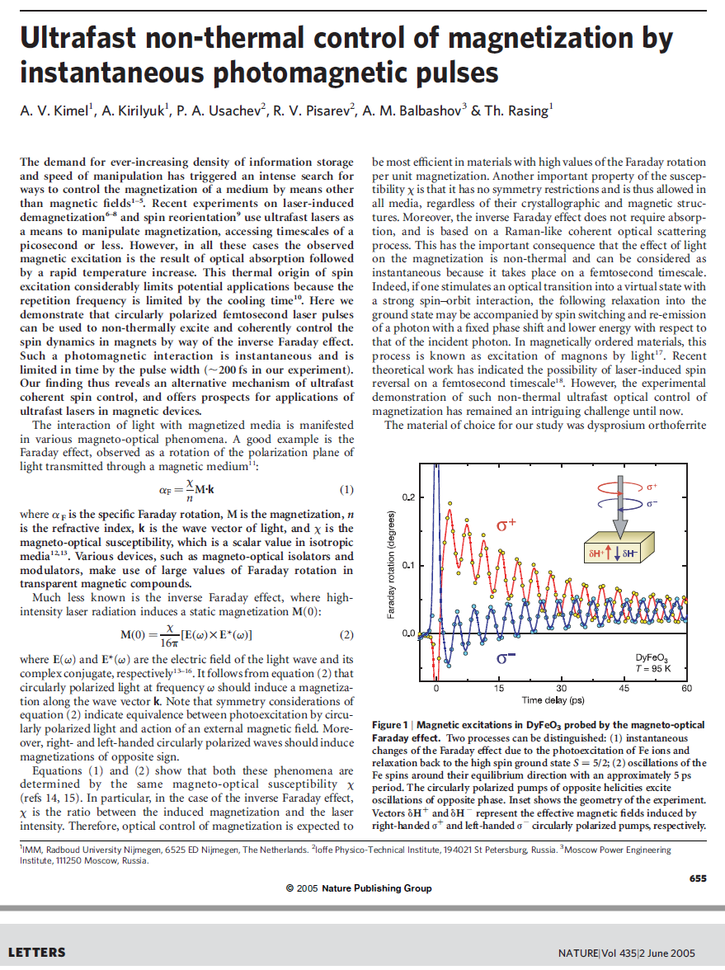
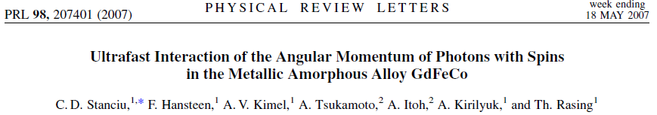
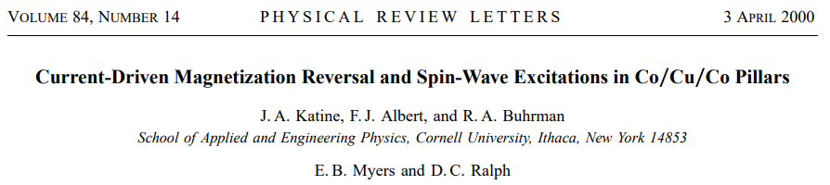
Electrical (All-Optical) Control of Magnetization
All-optical control of magnetization has always fascinated material
researchers in the field of spintronics and magnetic switching devices.
[1]
[4]
[2]
[5]
[3]
[6]

Slide 3
Electrical (All-Optical) Control of Magnetization
Mainly the focus has been placed on the spin magnetization.
There are 3 main studied mechanisms for electrical control of spin
magnetization:
Inverse Faraday Effect: Circularly polarized light ➔ Effective magnetic moment (usually spin) [1-4].
Rashba-Edelstein Effect: Charge current ➔ Spin polarization [5].
Spin-Transfer-Torque: Spin current ➔ Spin-wave polarization [6].

Slide 4
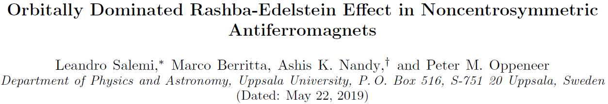
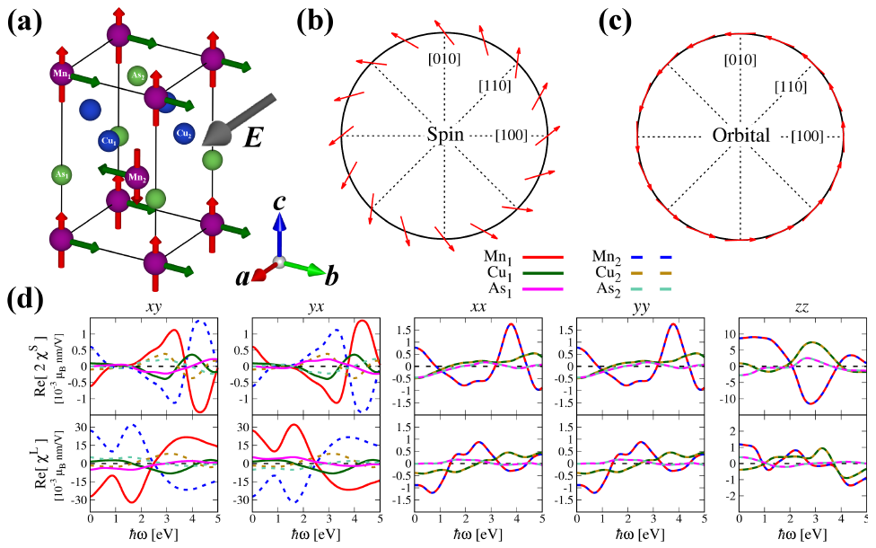
Orbital Magnetization in Rashba-Edelstein Effect
Recently, people are interested in the generation of orbital polarization together with spin polarization by Rashba-Edelstein effect.

Slide 5
Orbital Magnetization in Inverse Faraday Effect
Here, we think of orbital magnetic moment induced by the Inverse Faraday Effect.
Or the Berry curvature responses to the external circular driver.
We prefer a semiconductor TR symmetric system, such as MoS₂, since the orbital magnetization (Berry curvature) is expected to be more responsive to the external circular driver than the spin magnetization.
For valley materials, we can find net orbital magnetization or net valley magnetization as a result of circularly polarized phonon.
How can we measure this? What kind of quantity can be observed?

Slide 6
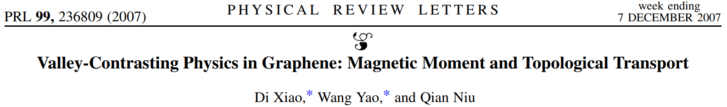

Orbital Magnetization vs. Berry Curvature
Net orbital magnetization is proportional to integrated Berry curvature.
If time-reversal symmetry is preserved ➔ Integrated Berry curvature should be zero.
These are static quantities. Can we show effective emergence of Berry curvature in dynamical situation ?
  YES. In time-average sense, we can show the time-averaged Hall conductivity.
  (time-averaged Hall current)/(static E-field bias) ➔ “time-averaged sense” Berry curvature.

Slide 7
Time-Dependent Calculation of Berry Curvature

Slide 8
Notes from Denis

Slide 9
Notes from Denis

Slide 10
Notes from Denis

Slide 11
Comparison: Orbital Term

Slide 12
Comparison: Intrinsic SOC Term

Slide 13
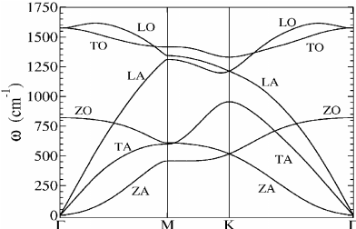
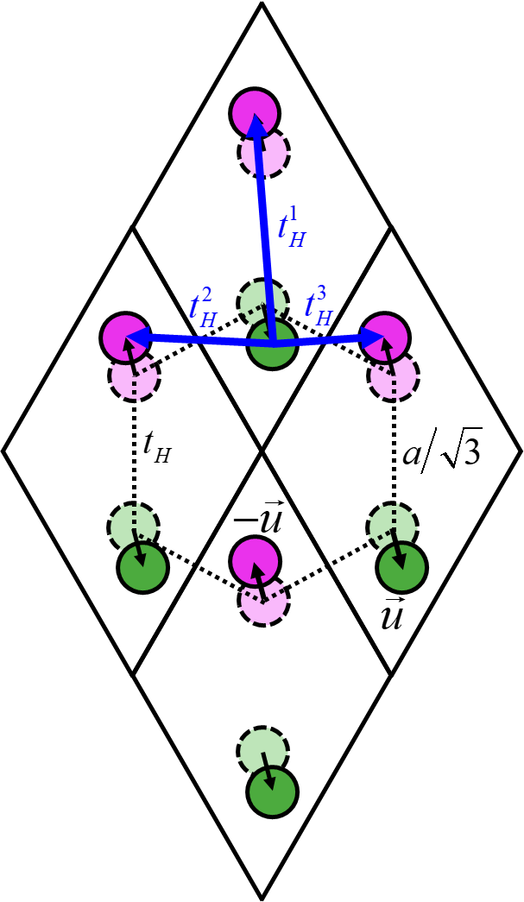
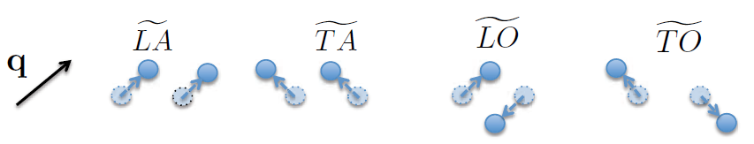
Graphene Model with In-plane Circular Phonon

Slide 14
TD Calculation of Berry Curvature with Phonon

Slide 15
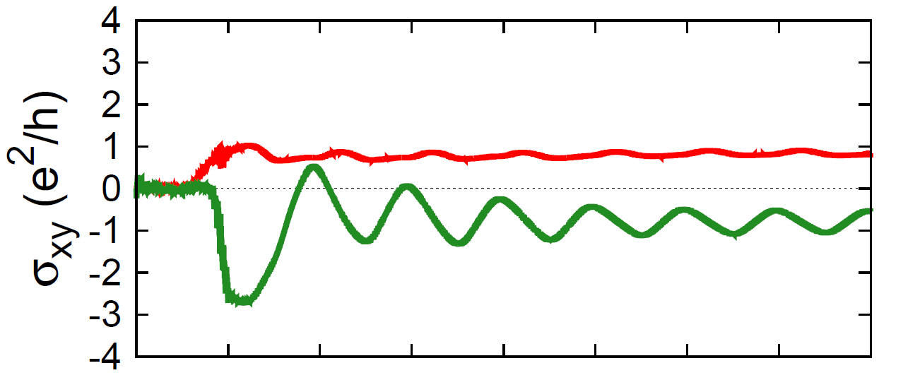
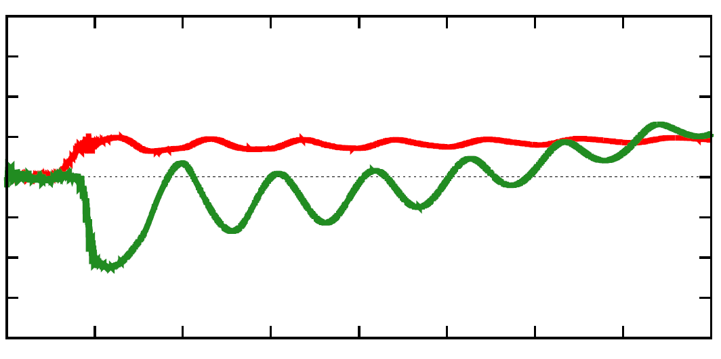
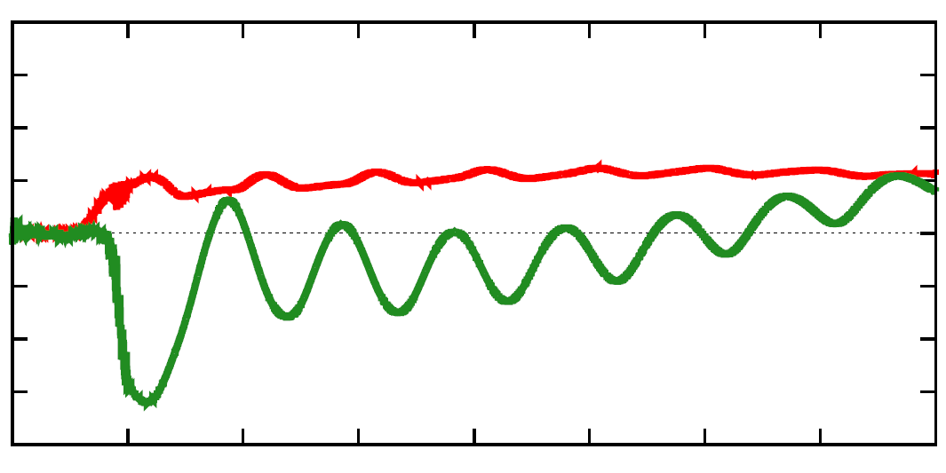
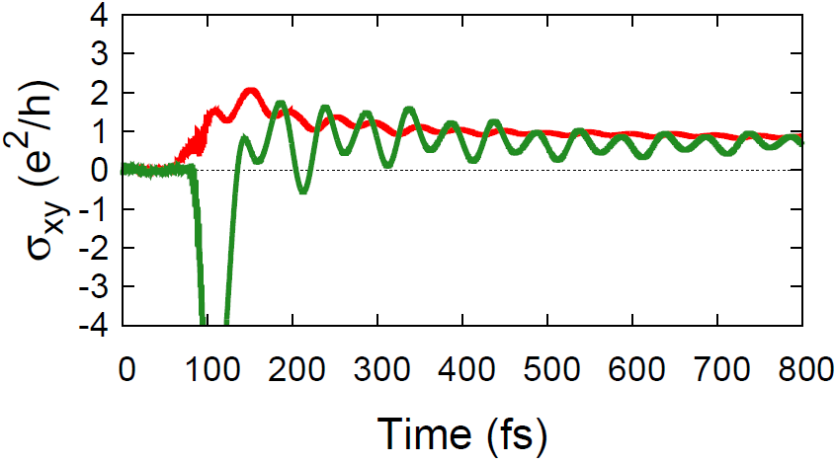
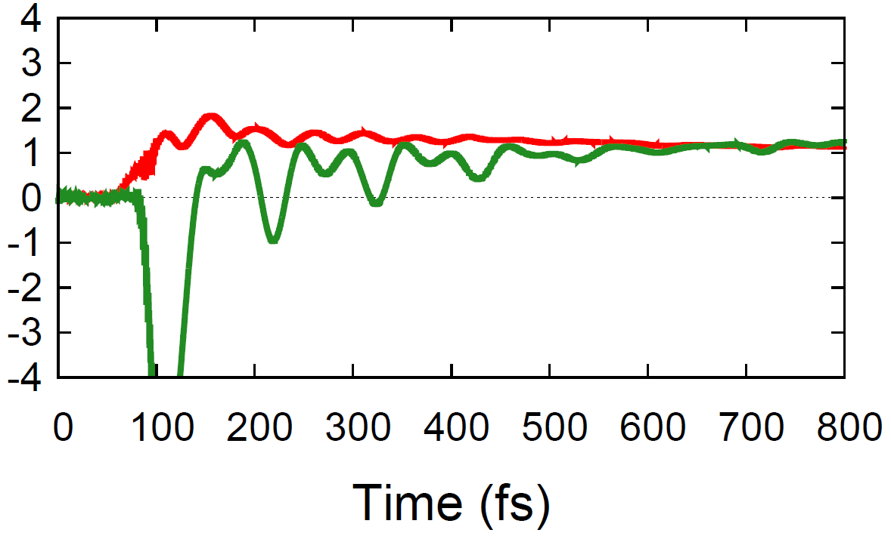
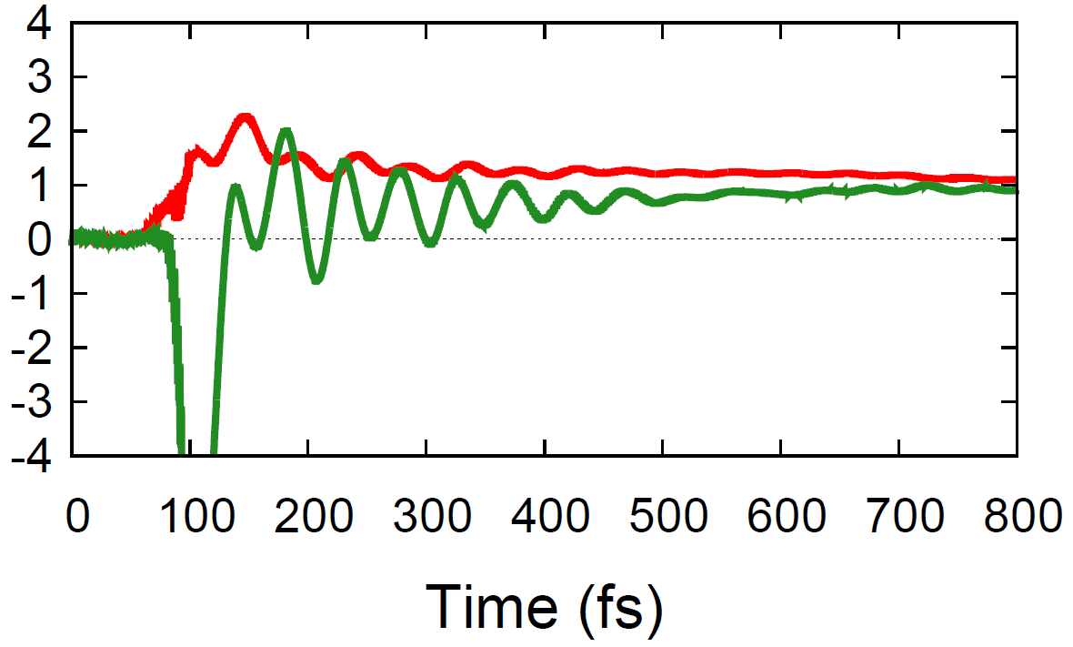
Resonance Between the Phonon and the DC Field
A constant charge Hall conductivity is observed when the period of the phonon is an integer multiple of the DC field’s period.

Slide 16
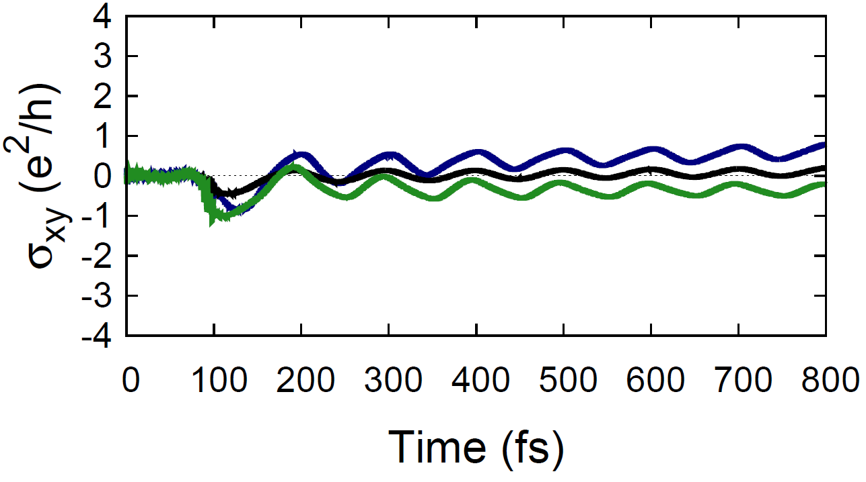
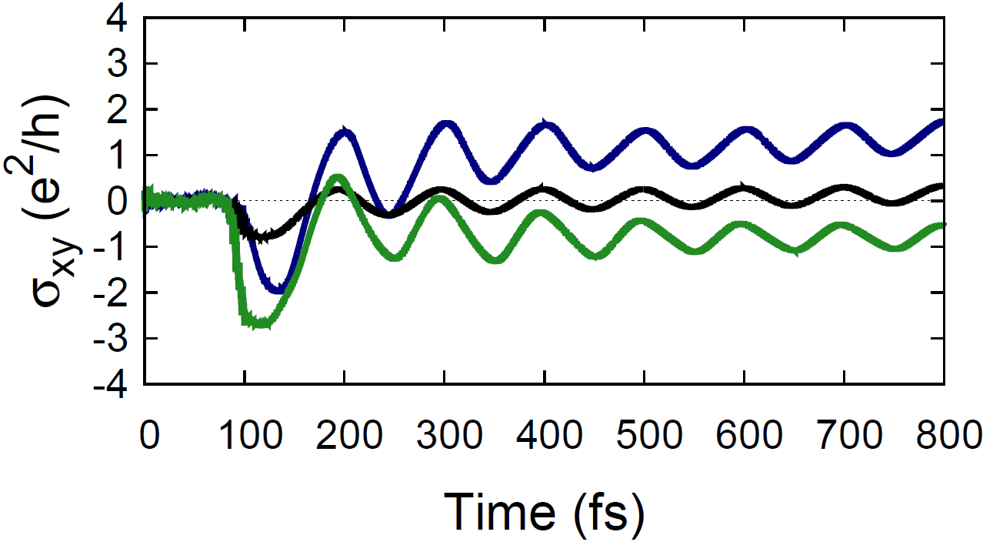
Requirements for Hall Conductivity
The sign and the magnitude of the charge Hall conductivity depends on the helicity and the amplitude of the phonon, respectively.
There is a lower and upper limit of the phonon amplitude for a physically meaningful Hall conductivity.

Slide 17
Orbital Magnetization without SOC
Even without SOC, there is a time-averaged constant Hall current ➔ Berry curvature ➔ orbital magnetization.

Slide 18
Orbital Magnetization with Inversion Symmetry
Even with inversion symmetry, there is a time-averaged constant Hall current ➔ Berry curvature ➔ orbital magnetization.
Optical circular phonon modes don’t break inversion symmetry but opens a gap at valley points, which may cause non-trivial topology.

Slide 19
k.p Hamiltonian near Valley Points
Let’s approximate the Hamiltonian near valley points:

Slide 20
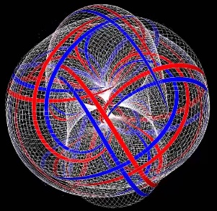
3D Berry Curvature for Dynamic Problems
We can parametrize the Hamiltonians in 3D parameter space as:
All three parameters are periodic in time, then the
parameter space can be assumed as a 3-torus.
Integration of Berry curvature over a surface on entire 3-torus space:

Slide 21
3D Berry Curvature for Dynamic Problems
Eigenvalues and eigenfunctions of Kramer’s pairs:

Slide 22
3D Berry Curvature for Dynamic Problems
Hamiltonian derivatives of Kramer’s pairs:

Slide 23
3D Berry Curvature for Dynamic Problems
Berry curvature components of Kramer’s pairs:
Integrated Berry curvature over BZ is zero.
Circular phonon changes amplitudes of the curvature peaks at valley tops independent of time, since is a constant.

Slide 24
3D Berry Curvature for Dynamic Problems
Berry curvature components of Kramer’s pairs:
Integrated Berry curvature over BZ is NOT zero. But we need:

Slide 25
3D Berry Curvature for Dynamic Problems
Berry curvature components of Kramer’s pairs:
Integrated Berry curvature over BZ is NOT zero. But we need:

Slide 26
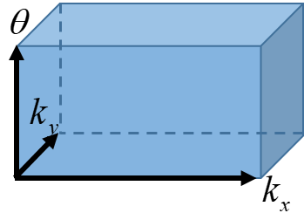
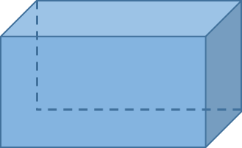
3D Berry Curvature for Dynamic Problems
Red line is a closed path on torus.
Red shaded area is a closed surface that encloses
the closed loop in 3-torus.
Normal of the surface is perpendicular to axis ➔ is cancelled.
Time reversal partners can be defined as:
Berry phase can be calculated by:
The closed path for :

Slide 27
3D Berry Curvature for Dynamic Problems
Berry curvature components of Kramer’s pairs:
Integrated Berry curvature over BZ is zero.
Circular phonon changes amplitudes of the curvature peaks at valley tops independent of time, since is a constant.

Slide 28
3D Berry Curvature for Dynamic Problems
Berry curvature components of Kramer’s pairs:
Integrated Berry curvature over BZ is NOT zero. But we need:

Slide 29
THANK YOU..

